Slide 1
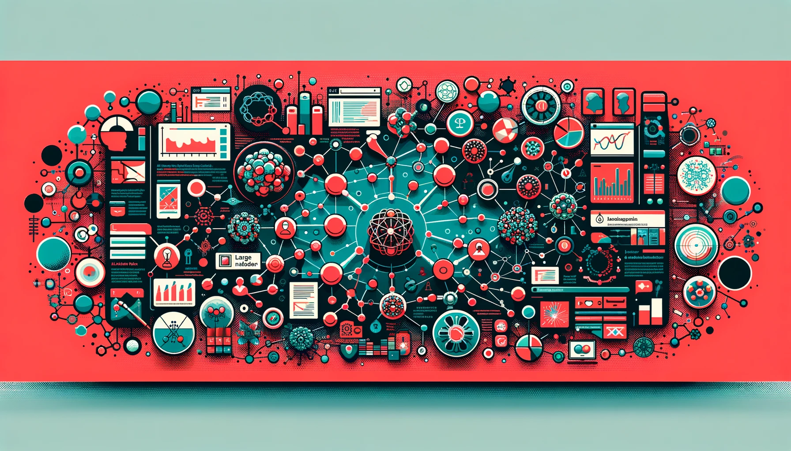
Co-Author Network Analysis and Understanding Impact of LLMs in Different Research Domains from Arxiv Data
Presented by
Nafis Tahmid Chowdhury, Shrishti Pathak, Mohammed Saidul Islam
EECS 6414 – Midterm project report| Winter 23-24

Slide 2

Motivation

Slide 3

Motivation
Networks are a powerful way to understand the collaborative nature of modern society and scientific progress.
The arXiv dataset - connectedness of authors
Collaboration - Sparks new ideas and advancements
Analyzing the arXiv dataset reveals patterns crucial for the scientific community.
Active researchers - Spotlights leading figures
Research trends - Predicts where science is heading
Breakthroughs - Identifies game-changing discoveries
The Networked Nature of Science
Networks, Scientific Collaboration, and the arXiv Dataset

Slide 4
Motivation
LLMs are reshaping research and have widespread potential across various fields.
Language understanding - Unlocks insights from massive amounts of text
Cross-disciplinary impact - Helps researchers across different fields
Responsible development - Ensures safe and fair use
LLMs: A Transformative Force
The Importance of Large Language Models (LLMs)

Slide 5
Problem Definition

Slide 6
Problem Definition
Questions:
Who are the key figures or hubs of collaboration within different fields?
How are communities of researchers structured (densely connected, loosely clustered, etc.)?
Can we trace how ideas and methods propagate through the network of researchers over time?
Network Analysis
The raw co-authorship data within the arXiv dataset doesn't directly reveal the underlying structure, relationships, and influences within the scientific community.

Slide 7
Problem Definition
Questions:
How are LLMs being used to facilitate collaborations across different fields?
Can LLMs help researchers break down traditional disciplinary boundaries?
How might LLMs influence the way research questions are formulated, or how findings are disseminated?
LLM Impact
The potential impact of Large Language Models (LLMs) on interdisciplinary research is a complex and rapidly evolving area.

Slide 8
Methodology

Slide 9
Methodology
Data Preparation Summary
Category Filtering: Artificial Intelligence (AI) and Computational Linguistics (CL) categories as these areas have the highest concentration of LLM research.
Temporal Filtering: Papers published from 2020 onwards were selected
Keyword Refinement: The data was refined using keywords specific to Large Language Models (LLMs) and ChatGPT (e.g., 'language model', 'BERT', 'GPT-3') targeting both titles and abstracts.
Data Preprocessing for Co-Authorship Network Analysis

Slide 10
Methodology
Network Construction Preparation:
Metadata Extraction: Relevant information, including titles, abstracts, authors, and publication dates
Author Name Standardization: Author names were standardized into a consistent format
Co-author Identification: All co-author pairs were extracted from each paper, representing the collaborative
Data Preprocessing for Co-Authorship Network Analysis

Slide 11
Network Analysis & Visualization

Slide 12
Network Analysis
Network Construction
Authors become nodes in the network.
Co-authorship relationships become edges connecting the authors.
Edge weights: Represent the frequency of collaborations, showing stronger ties between frequent co-authors
Network Refinement
Focused Subgraph: Include only authors with at least two publications since 2020 (or adjust criteria based on your project).
Remove Isolated Nodes: Authors without collaborations within the filtered group are removed for a focused analysis on the interconnected core of the network.
Initial Co-Authorship Network Analysis

Slide 13
Network Analysis
Visualization with PyVis
Interactive Graph: Authors as nodes, co-authorship ties as edges.
Edge Thickness: Indicates intensity of collaboration.
Visual Exploration: Allows identifying central researchers, clusters, and research communities.
Network Visualization

Slide 14
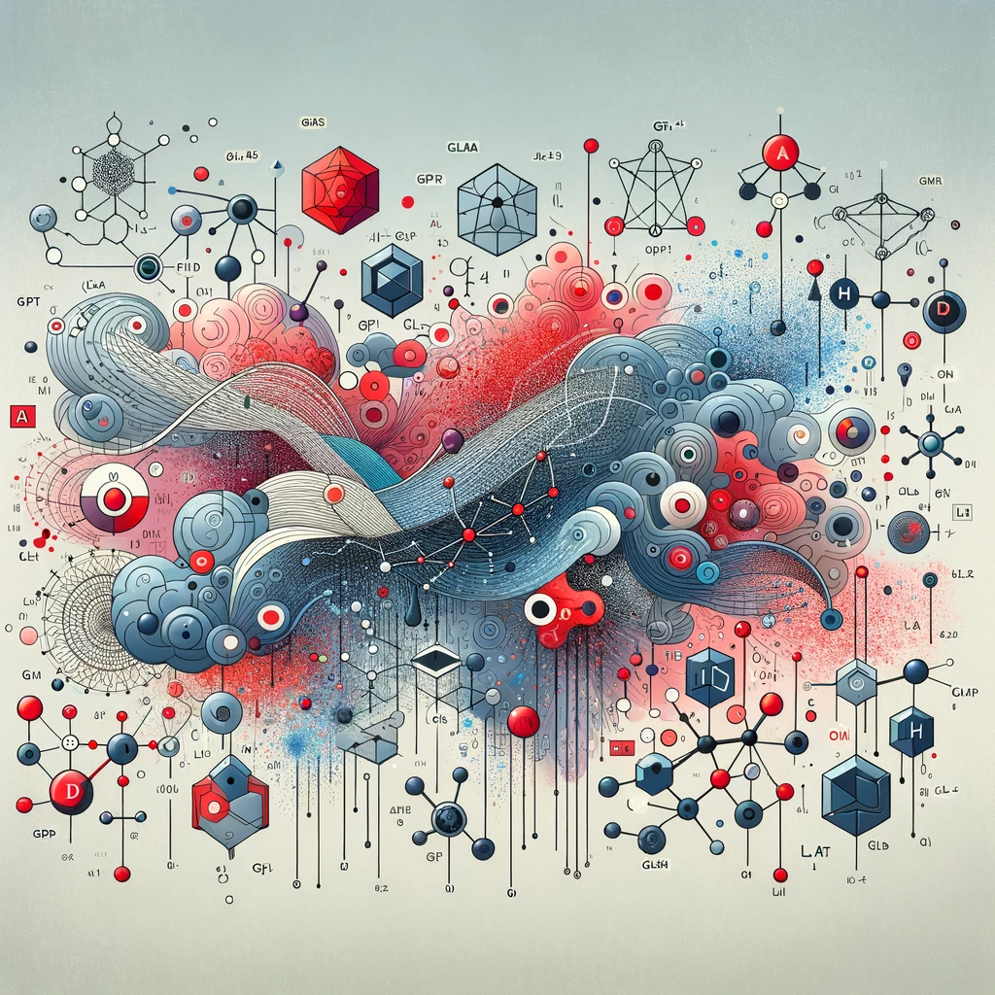
Conclusion & Future Work
In conclusion, this project aims to explore the arxiv dataset to
intricate connections among researchers
valuable insights into the collaborative landscape of scientific domains
Next, we want to explore
potential impact of LLMs in NLP as well as interdisciplinary research over a period of time
construct an author affiliation network, examining the dynamic relationship between academia and industry
Thank You

